Slide 1

Pandas
Are you using it efficiently?

Slide 2
Why This Tutorial?
Pandas is a powerful tool
Inefficient when used incorrectly
Significantly improves coding efficiency (writing & running) when mastered
Not trivial to use inside a big project (we will see why)

Slide 3
Outline & Schedule
First hour: Lecture with code snippets
Pandas is Column-Major – why you should care
The dreadful SettingWithCopyWarning
Accessors
Groupby
Windowing Operations
Merging Tables
Plotting with Pandas
GeoPandas
Using Pandas in your project – practical design pattern
Second hour: Guided exercise

Slide 4
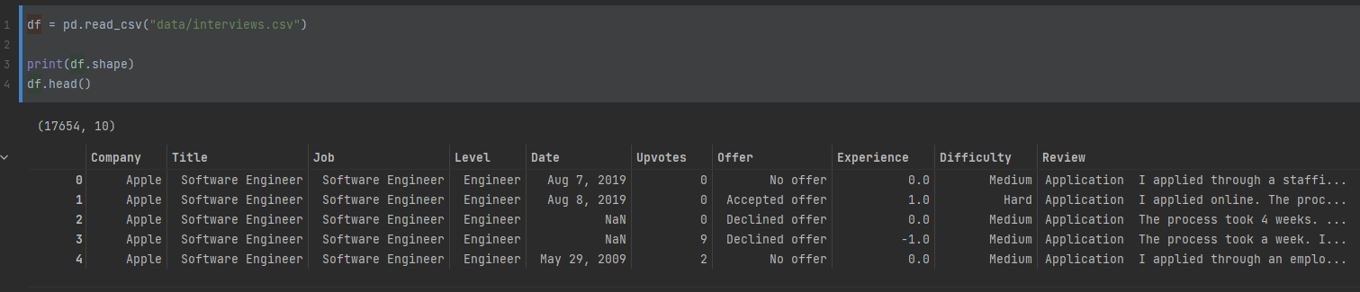
Toy Dataset: Tech Interviews

Slide 5
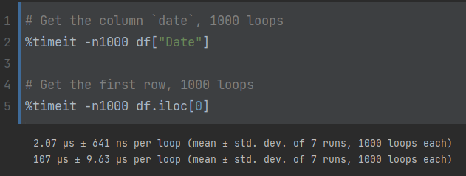
1. Pandas is Column-Major
Column-major: consecutive elements in a column are stored next to each other in memory.
Accessing a row is 50x slower than accessing a column!

Slide 6
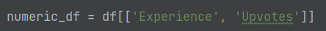
1.1 Applying a function to all rows
Goal: multiply Experience with Upvotes for each interview

Slide 7
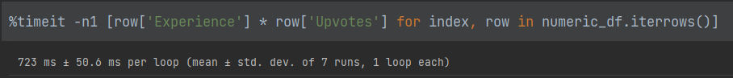
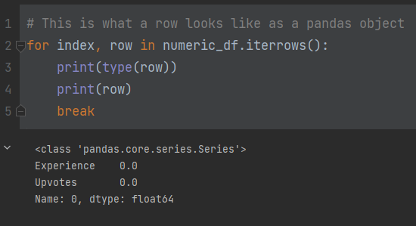
1.1.1. .iterrows() and .itertuples()
Iterrows:
Why so slow?

Slide 8
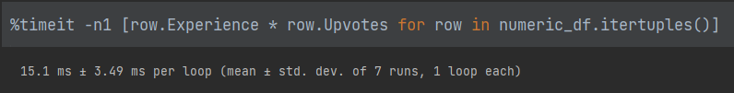
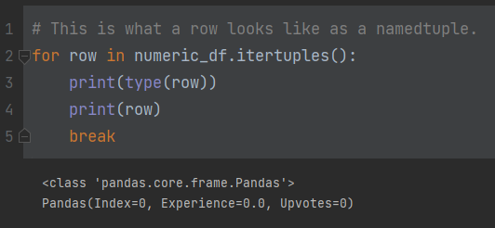
1.1.1. .iterrows() and .itertuples()
Itertuples:
What changed???

Slide 9

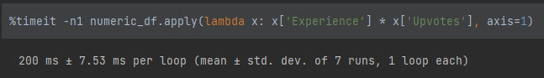
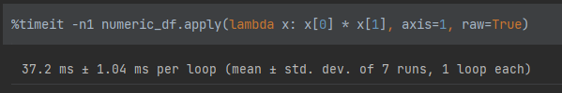
1.1.2. .apply(axis=1)
Naïve (but reasonable!) try:
Way worse than itertuples! WHY??
apply(axis=1), like iterrows, transforms rows to Series
We can partially overcome this:
Still 2-3x worse than itertuples! I have no good explanation.

Slide 10
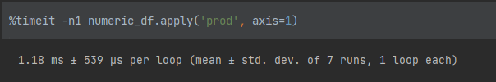
1.1.2. .apply(axis=1) (cont.)
Built-in functions:
Noice! But why?
Highly optimized Cython code
We can also enhance our custom function's performance by implementing it in Cython or using numba.jit, but it is out of our scope

Slide 11
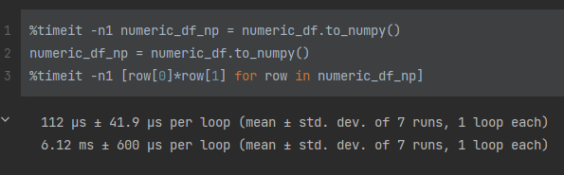
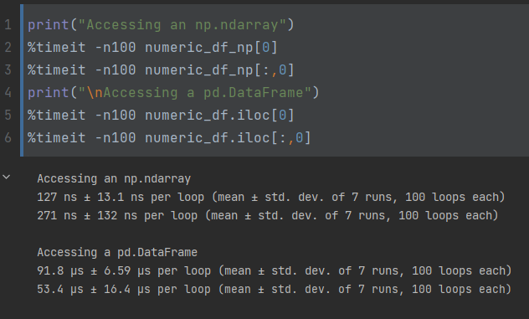
1.1.3 Converting df to row-major
Numpy accessing is much faster:

Slide 12
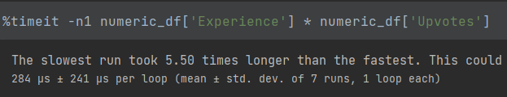
1.1.4. Vectorizing
Always the best choice! (when possible)

Slide 13
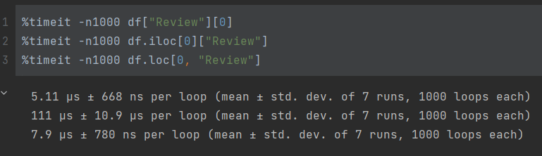
1.2. Ordering Slicing Operations
What’s fastest?

Slide 14
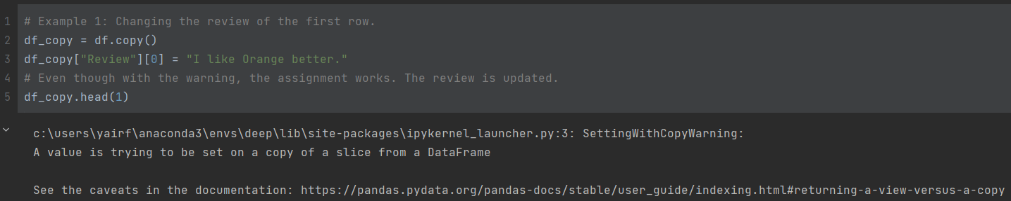
2. SettingWithCopyWarning

Slide 15
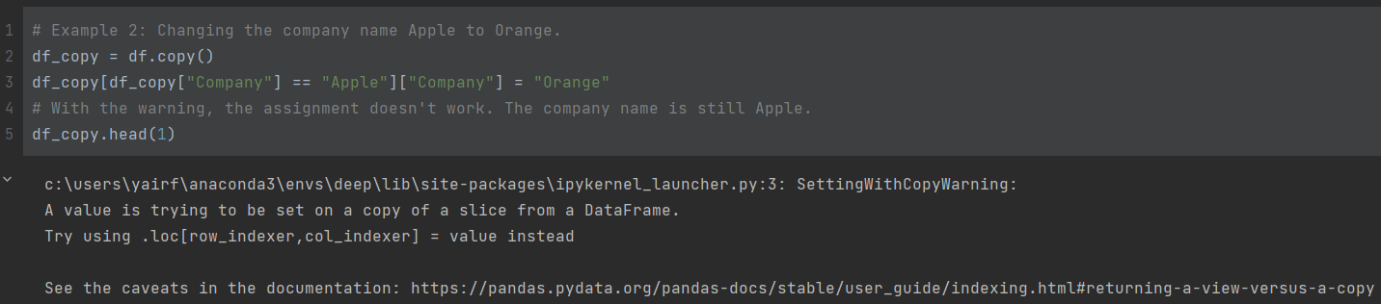
2. SettingWithCopyWarning (cont.)

Slide 16
2.1. View vs. Copy
View is the actual DataFrame you want to work with.
Copy is a copy of that actual DataFrame, which will be thrown away as soon as the operation is done.
SettingWithCopyWarning: you're making changes to might be a `Copy` or a `View`, and pandas can't tell you.
Source of ambiguity: the __getitem__ operation. Sometimes returns a copy, sometimes a view. No guarantees.

Slide 17
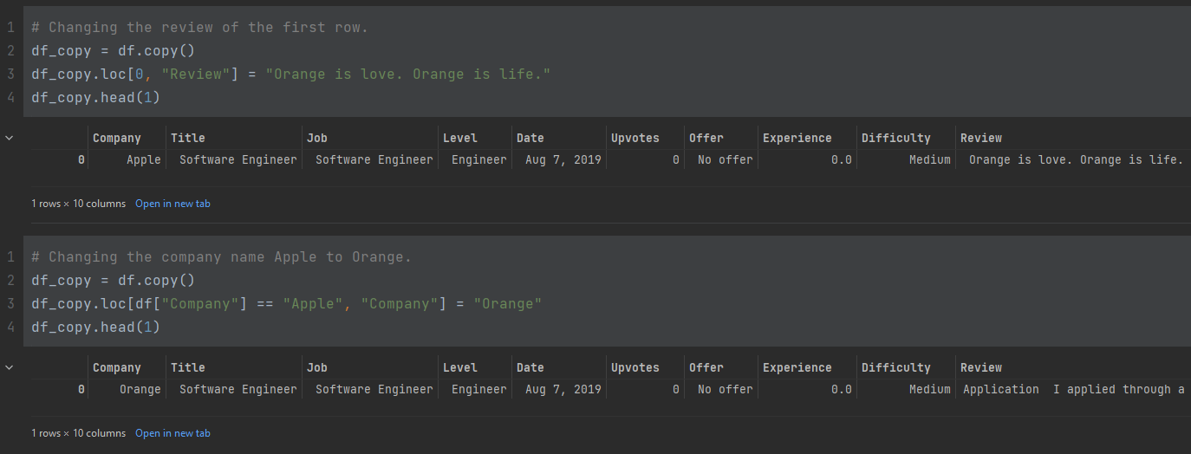
2.2. SettingWithCopyWarning - Solutions
1. Combine all chained operations into one single operation using .loc[]

Slide 18
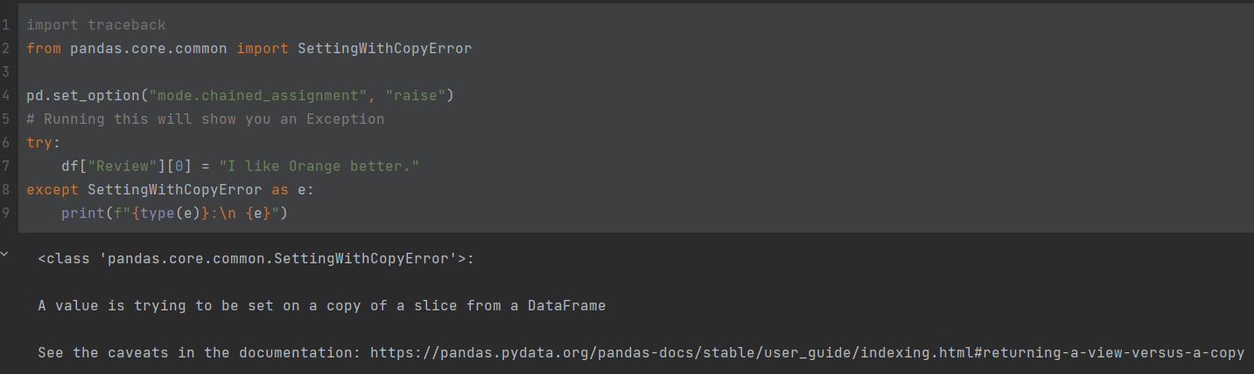
2.2. SettingWithCopyWarning - Solutions
2. Raise an error (good practice!)

Slide 19
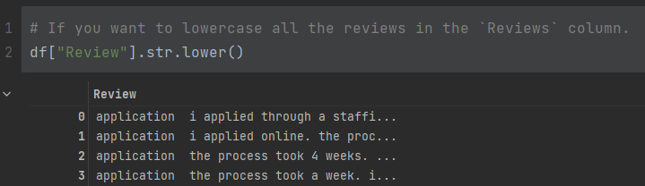
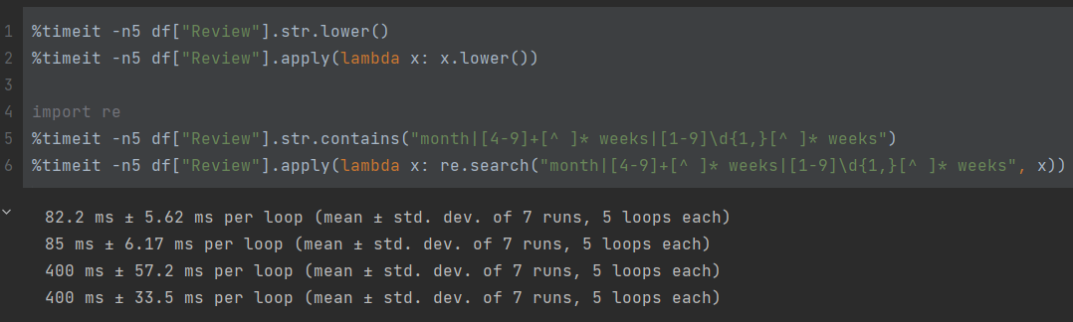
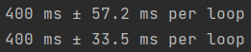
3. Accessors
String accessor:
Neat. Is it faster?

Slide 20
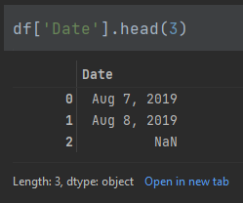
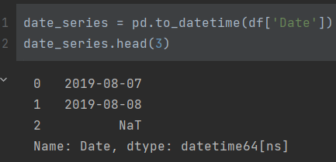
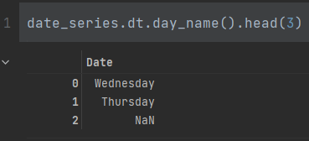
3. Accessors (cont.)
Datetime accessor:

Slide 21
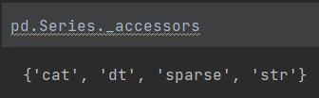
3. Accessors (cont.)
There are two more accessors:
Cat: handles categorical data
Sparse: handles sparse data
Not covered in this tutorial ☺

Slide 22
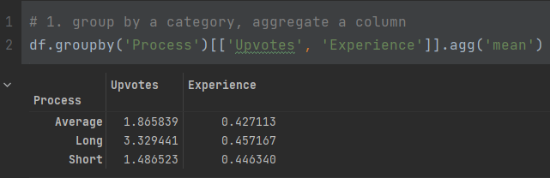
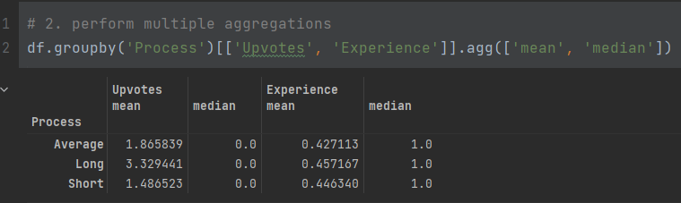
4. GroupBy

Slide 23
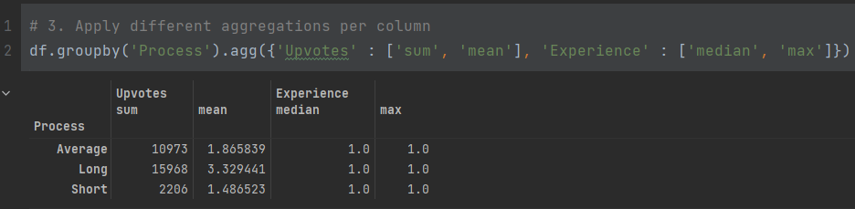
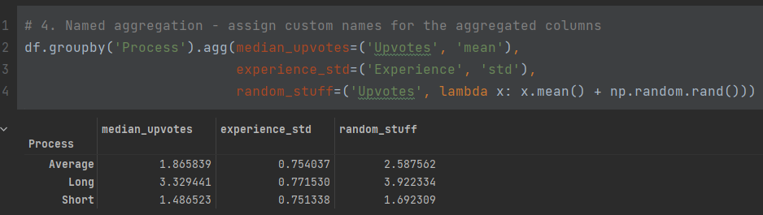
4. GroupBy (cont.)

Slide 24
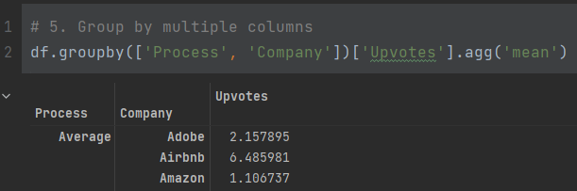
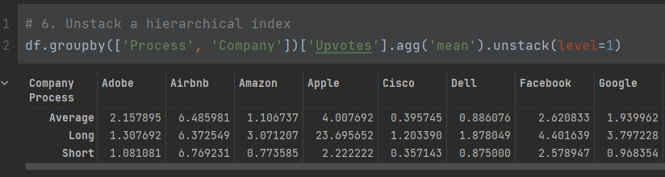
4. GroupBy (cont.)

Slide 25
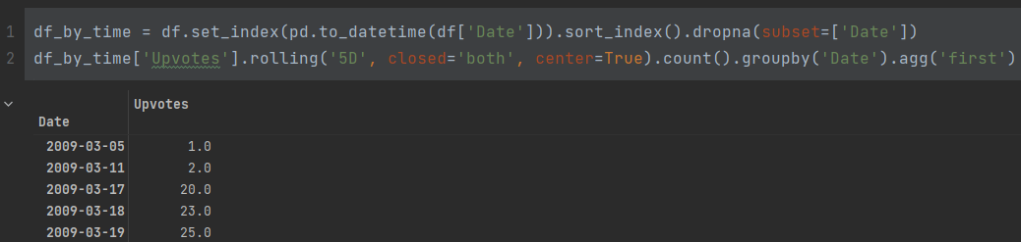
5. Windowing Operations
Lets find out the amount of upvotes in each window of 5 days:

Slide 26
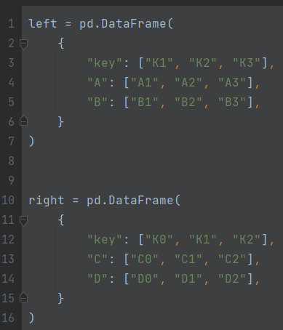
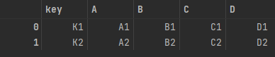
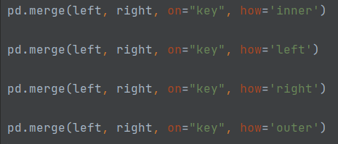
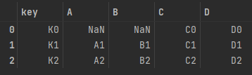
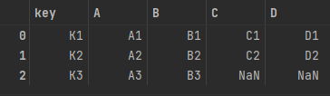
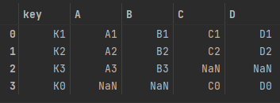
6. Combining Data From Multiple Tables

Slide 27
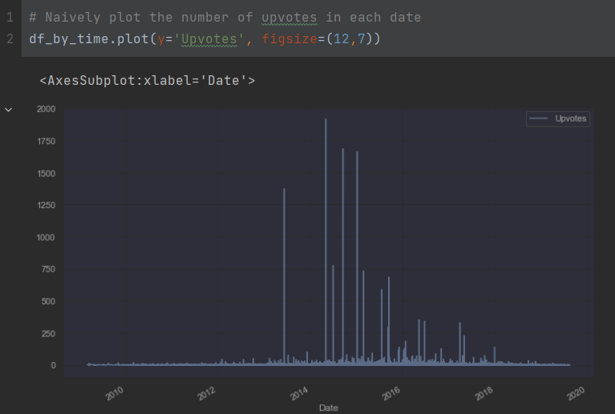
7. Plotting With Pandas

Slide 28
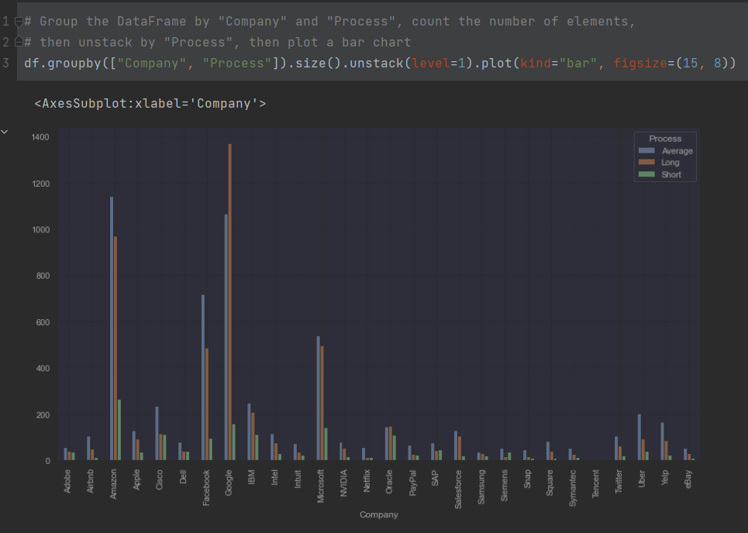
7. Plotting With Pandas (cont.)

Slide 29
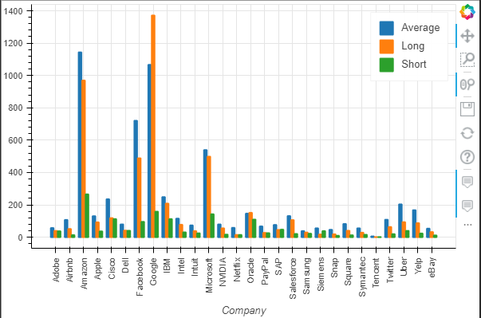
7.1. Want Interactivity? Pandas-bokeh!

Slide 30
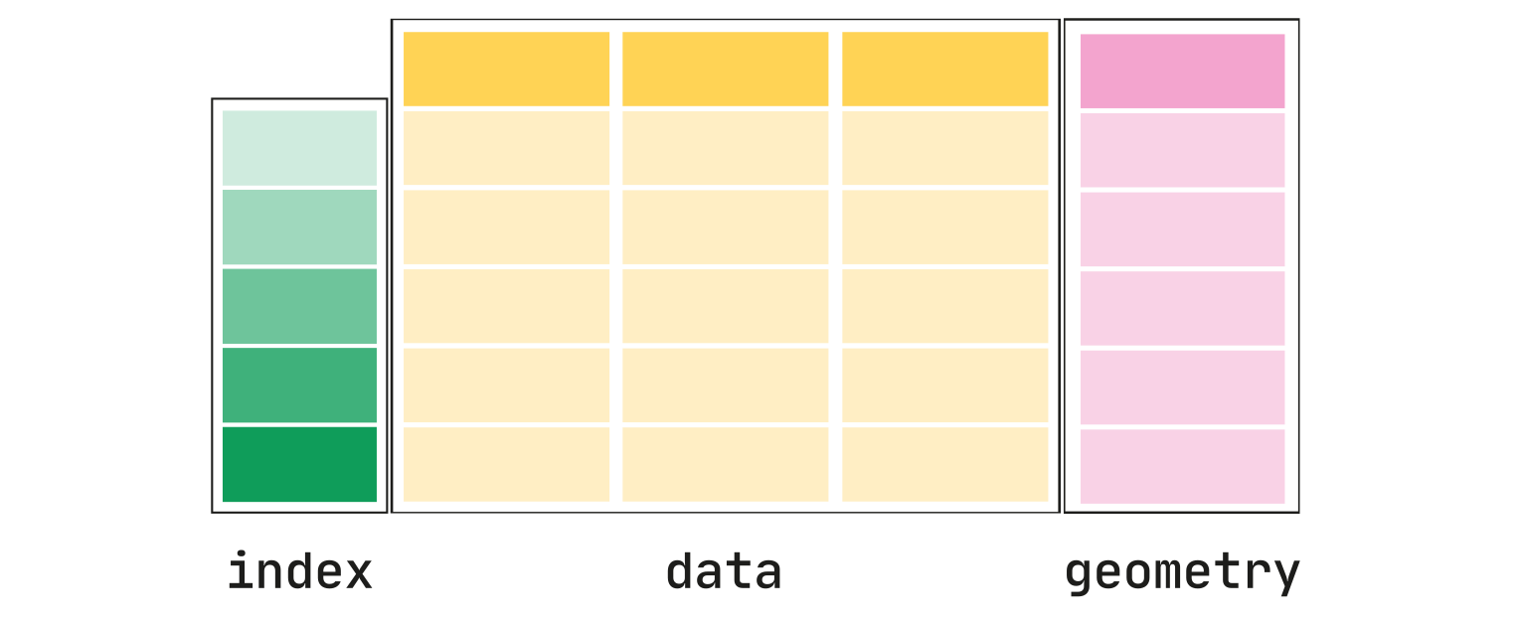
8. GeoPandas

Slide 31
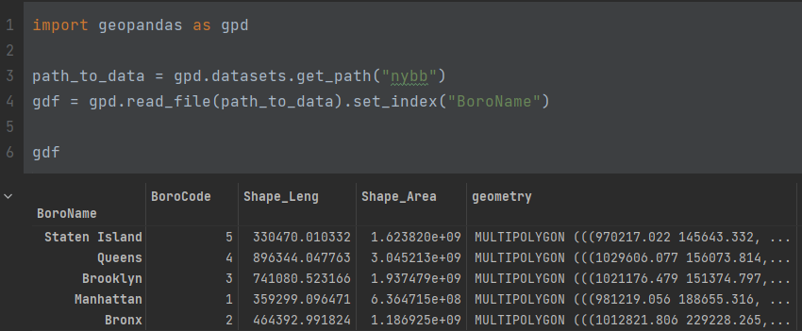
8. GeoPandas (cont.)

Slide 32
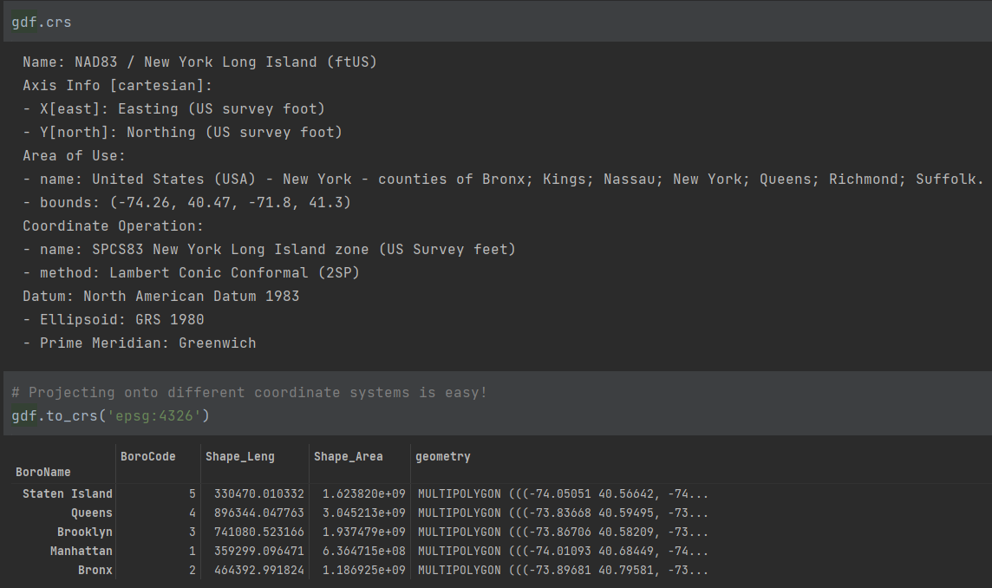
8. GeoPandas – Coordinate Systems

Slide 33
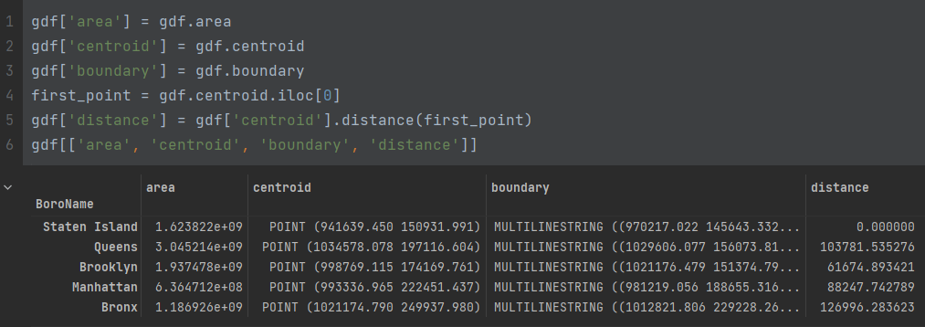
8.1. GeoPandas – Geometric Ops

Slide 34
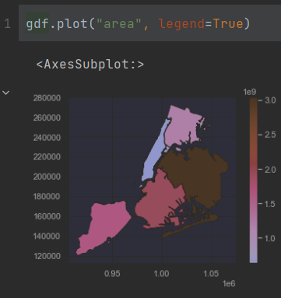
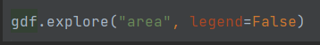
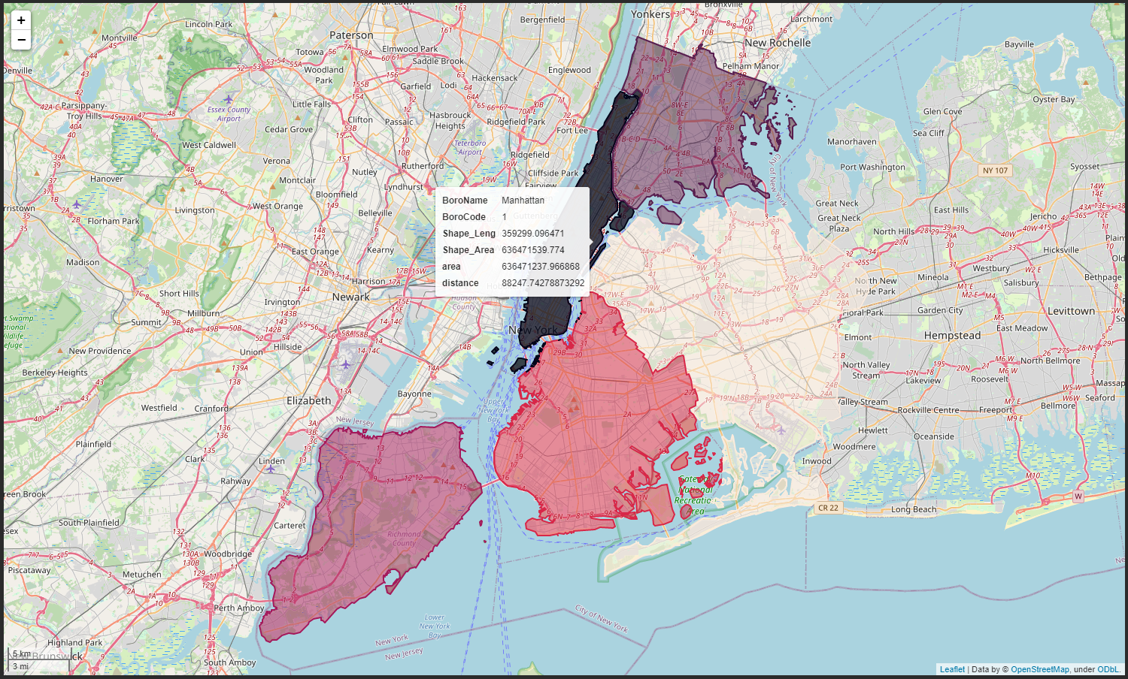
8.2. GeoPandas – Plotting Maps
Static Maps
Interactive Maps (folium)

Slide 35
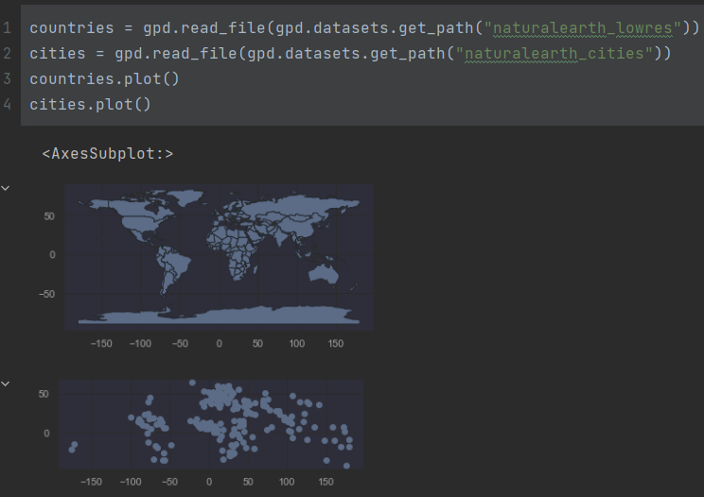
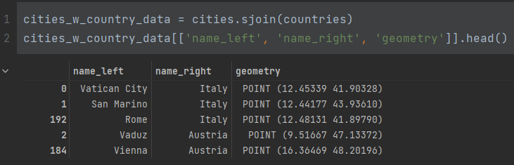
8.3. GeoPandas – Spatial Joins

Slide 36
Using Pandas in Your Project

Slide 37

Why is using pandas in a project hard?
What are the available columns?
Are there other modules that use this data type? How?
No help from IDE
Must debug
Will probably curse and cry
Reminds anyone of ExperimentData? 😨

Slide 38

DfWrapper: A design pattern to overcome some of the difficulties
The basic idea: wrap a raw dataframe object with a class, and assign a set of columns to that class.

Slide 39

DfWrapper: Example

Slide 40

Now Go Exercise!

